Slide 1
Respiratory System
Anatomy of the Respiratory System
Pulmonary Ventilation
Gas Exchange and Transport
Respiratory Disorders

Slide 2
Pulmonary ventilation
the inhalation and exhalation of air and involves the exchange of air between the atmosphere and the alveoli of the lungs.
External (pulmonary) respiration is the exchange of gases between the alveoli of the lungs and the blood in pulmonary capillaries across the respiratory membrane. In this process, pulmonary capillary blood gains O2 and loses CO2.

Slide 3
Internal (tissue) respiration is the exchange of gases between blood in systemic capillaries and tissue cells. In this step the blood loses O2 and gains CO2. Within cells, the metabolic reactions that consume O2 and give off CO2 during the production of ATP are termed cellular respiration.

Slide 4
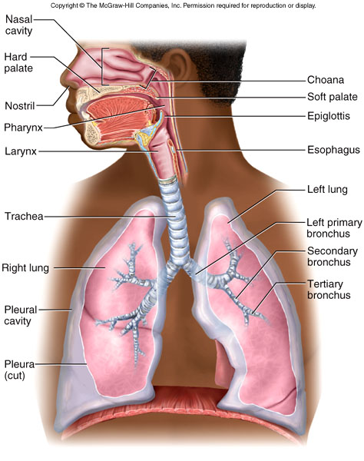
Organs of Respiratory System
Nose, pharynx, larynx, trachea, bronchi, lungs

Slide 5
General Aspects
Airflow in lungs
  bronchi → bronchioles → alveoli
Conducting division
  passages for airflow, nostrils to bronchioles
Respiratory division
  distal gas-exchange regions, alveoli
Upper respiratory tract
  organs in head and neck, nose through larynx
Lower respiratory tract
  organs of thorax, trachea through lungs

Slide 6
Lungs
Respiration;
Internal [gas exchange between cells & ECF- tissue respiration]
external [gas exchange through lungs- pulmonary respiration]
Respiratory system contains Gas exchanging organ [lungs] & Pump [respiratory muscles, brain areas and nerves innervating respiratory muscles]
Respiratory rate 12 – 15/min, TV 500 ml.
Partial pressure of a gas:
21% O_{2;} Barometric pressure=760 mmHg.
PO₂ = 760X21/100 = 160 mmHg.
0.4% CO₂ Barometric pressure 760mmHg
PCO₂ = 760X4/10X1/100 = 0.3mmHg.

Slide 7
Lungs
Air passage – Trachea, bronchi, bronchioles, terminal bronchioles, respiratory bronchioles, alveolar duct & alveoli (300 million)
Zones: First 16 generations … conducting zone (bronchi bronchioles, terminal bronchioles)
Next 7 generation... transitional zone [respiratory bronchioles, alveolar duct & alveoli (300 million)]
Cross sectional area of trachea 2.5 cm²
Cross sectional area of alveoli 11800 cm².

Slide 8
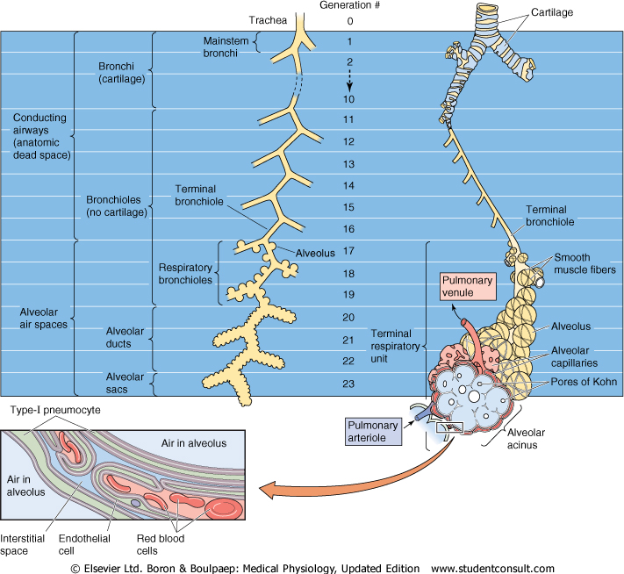

Slide 9
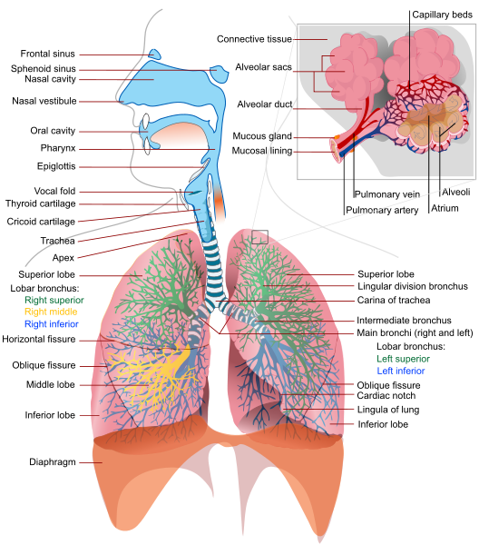
Lungs

Slide 10
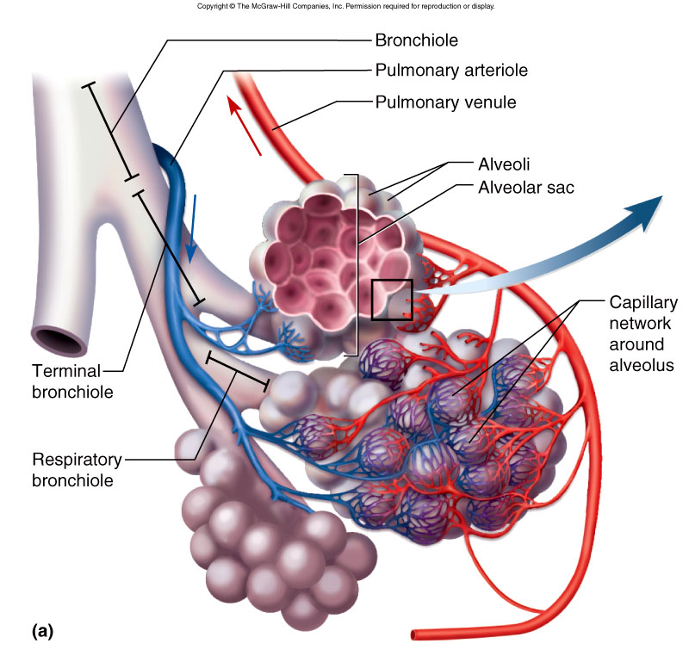
Alveolar Blood Supply

Slide 11
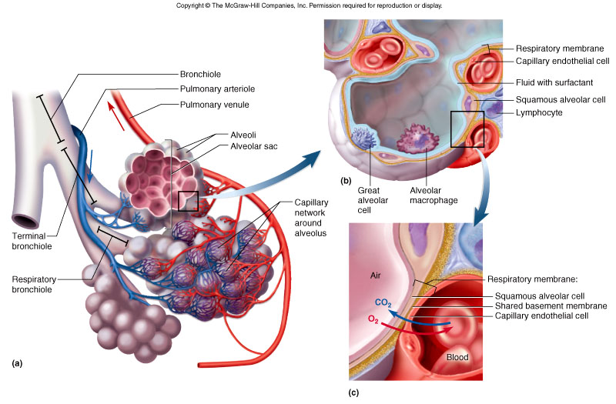
Alveolus

Slide 12
Pulmonary Ventilation
Breathing (pulmonary ventilation) – one cycle of inspiration and expiration
  quiet respiration – at rest
  forced respiration – during exercise
Flow of air in and out of lung requires a pressure difference between air pressure within lungs and outside body

Slide 13
Pulmonary ventilation is a mechanical process that depends on volume changes in the thoracic cavity. volume changes lead to pressure changes, and pressure changes lead to the flow of gases to equalize the pressure.

Slide 14
Respiration
The relationship between the pressure and volume of a gas is given by Boyle’s law: At constant temperature, the pressure of a gas varies inversely with its volume. That is,
P ∝ (1/V)
P₁V₁ = P₂V₂
how this relates to inspiration and expiration?

Slide 15
Inspiration
during normal quiet inspiration, when the inspiratory muscles—the diaphragm and external intercostal muscles—are activated.
Action of the diaphragm.
  When the diaphragm contracts, it moves inferiorly and flattens out. As a result, the superior-inferior dimension (height) of the thoracic cavity increases.

Slide 16
Action of the intercostal muscles.
  Contraction of the external intercostal muscles lifts the rib cage and pulls the sternum superiorly. But when the ribs are raised and drawn together, they swing outward, expanding the diameter of the thorax both laterally and in the anteroposterior plane.

Slide 17
these actions expand the thoracic dimensions by only a few mm increasing thoracic volume by almost 500 ml—the tidal volume. Of the two types of inspiratory muscles, the diaphragm is far more important.

Slide 18
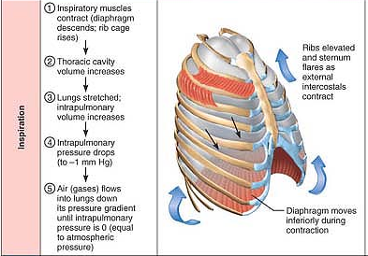

Slide 19
As the thoracic dimensions increase during inspiration, the intrapulmonary volume increases. As a result, P_{pul} drops about 1 mm Hg relative to P_{atm}. Anytime the intrapulmonary pressure is less than the atmospheric pressure (P_{pul} < P_{atm}), air rushes into the lungs along the pressure gradient. Inspiration ends when P_{pul} = P_{atm}.

Slide 20
Expiration
Quiet expiration is a passive process that depends more on lung elasticity than on muscle contraction. As the inspiratory muscles relax, the rib cage descends and the lungs recoil.
The thoracic and intrapulmonary volumes decrease and compresses the alveoli.
P_{pul} rises to about 1 mm Hg above P_{atm}. When P_{pul} > P_{atm}, the pressure gradient forces gases to flow out of the lungs.

Slide 21
Forced expiration is an active process produced by contraction the oblique and transversus muscles. These contractions
(1) increase the intra-abdominal pressure and
(2) depress the rib cage. The internal intercostal muscles also help to depress the rib cage and decrease thoracic volume.

Slide 22
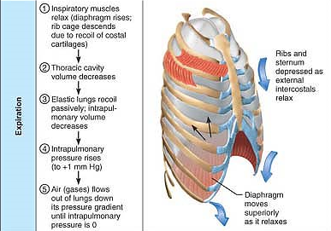

Slide 23
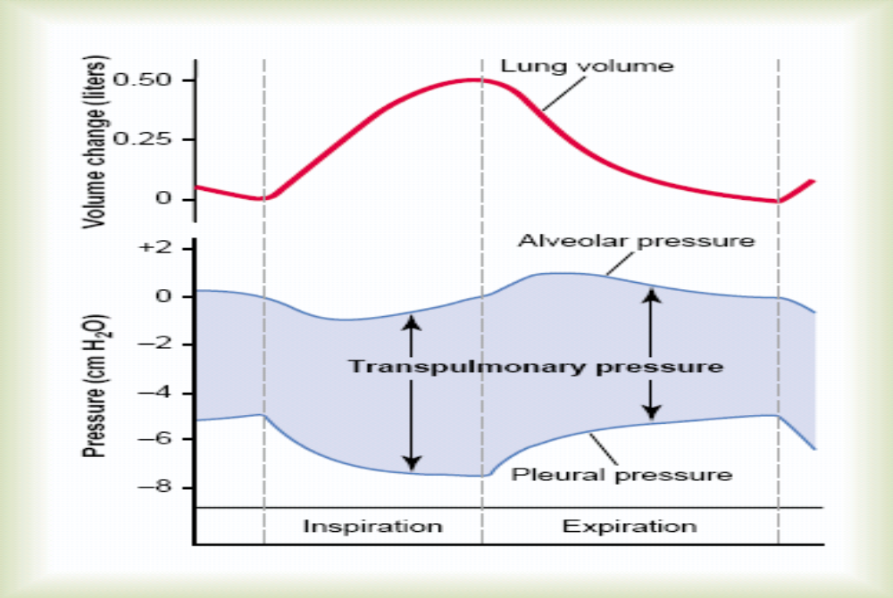
Changes in pressure during normal breathing

Slide 24
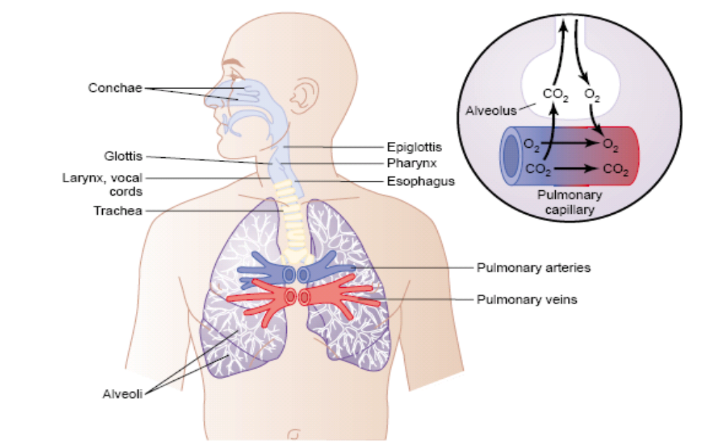
Respiratory passage

Slide 25
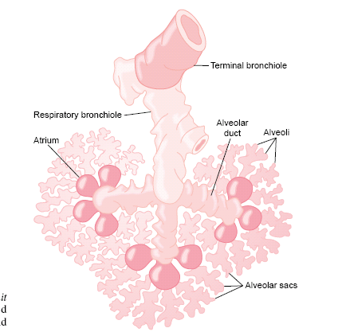
Respiratory unit

Slide 26
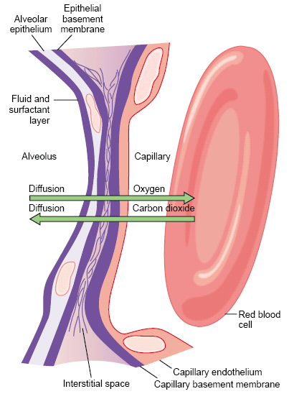
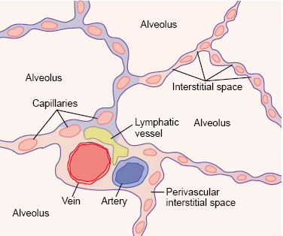
Diffusion of gases through the respiratory membrane

Slide 27
Factors that affect the rate of gas diffusion through the respiratory membrane
The thickness of the membrane
The surface area of the membrane
The diffusion coefficient
The partial pressure difference of the gas between the two sides of the membrane

Slide 28
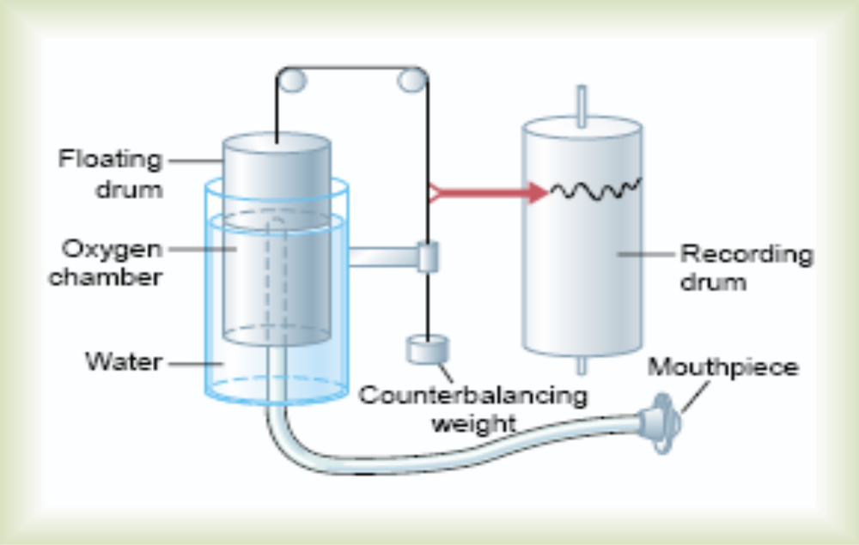
Spirometry:

Slide 29
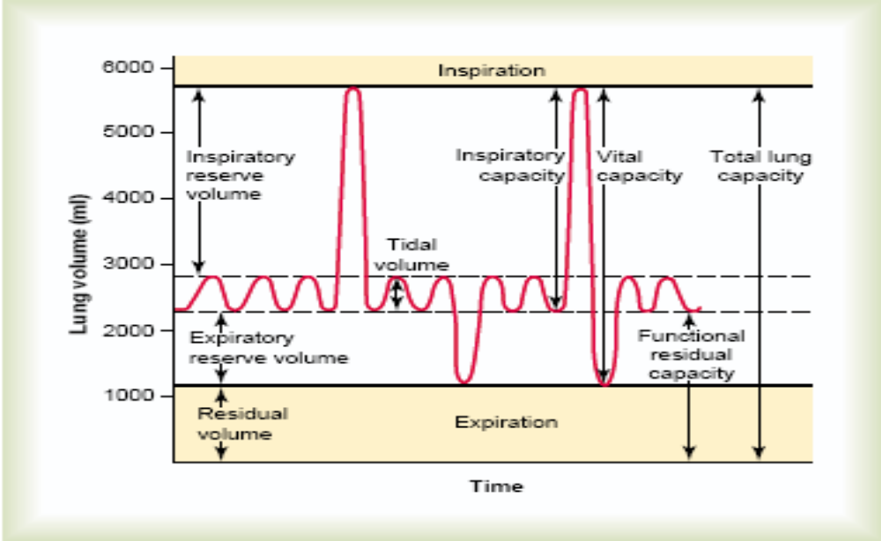
Pulmonary volumes and capacities:

Slide 30
Some more volumes relevant to pulmonary physiology
Minute volume (MV): Tidal Volume X Respiratory rate per min.
Maximum Voluntary Ventilation (MVV): maximum amount of air that can be breathed out by the lungs in a min.
Breathing reserve (BR): MVV – MV.
Dead space: Anatomical and physilolgical dead space.

Slide 31
Conti….
Pulmonary ventilation (PV) and alveolar ventilation (AV): MV is considered a measure of PV. AV is (TV- dead space) X RR per min.

Slide 32
Cyanosis
5 g. deoxygenated Hb per 100 ml of blood.
Central cyanosis: hypoxic hypoxia
Peripheral cyanosis :stasis of blood in tissue capillaries
Cyanosis in different hypoxia:
1.hypoxic 2.anaemic 3.stagnant 4. histotoxic
yes no yes no

Slide 33
Dyspnoea:
if the % BR falls below 60%.
Causes: due to
-altered discharge from airway receptors, lung receptors or respiratory muscle proprioceptors.
-left ventricular failure, the lungs are congested.
-orthopnea is seen in bilateral paralysis of the diaphragm.

Slide 34
Neural Control of Breathing
Breathing depends on repetitive stimuli from brain
Neurons in medulla oblongata and pons control unconscious breathing
Voluntary control provided by motor cortex
Inspiratory neurons: fire during inspiration
Expiratory neurons: fire during forced expiration

Slide 35
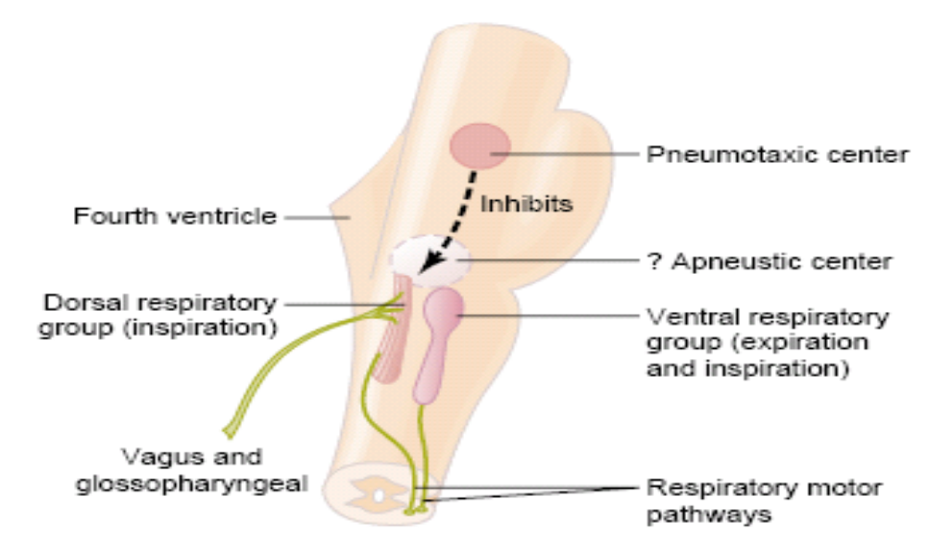
Respiratory centers
Galen (131- 200 A. D.)

Slide 36
Respiratory Control Centers
Medullary respiratory group
  inspiratory center (dorsal respiratory group)
    frequent signals builds up gradually during respiration,
    signals terminates during expiration.
    the normal rhythm of quiet breathing is generated from DRG.
  expiratory center (ventral respiratory group)
    normally silent during inspiration
    involved in forced expiration as during exercise.

Slide 37
Why it is impossible to commit suicide by holding the breath voluntarily?

Slide 38
Chemoreceptors
Central chemoreceptors
  in ventral surface of medulla near the exit of ninth and tenth cranial nerve
    primarily monitor is pH of CSF
    Physiological stimulus is an increase in PCO2

Slide 39
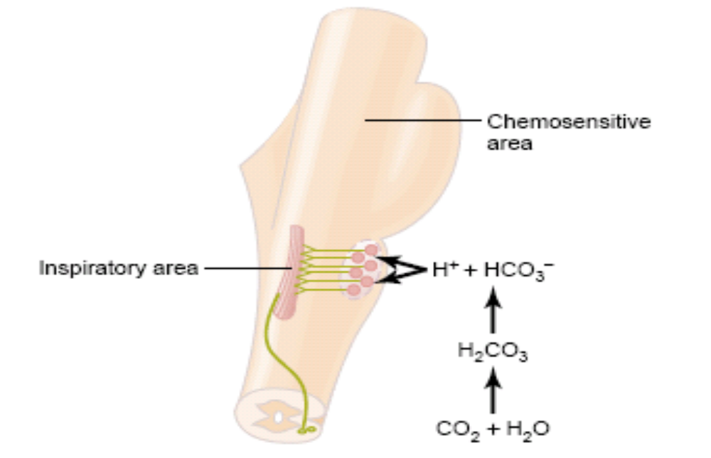
Chemoregulation of respiration

Slide 40
Peripheral chemoreceptors
  found in major blood vessels
  The cells present in these structures are called glomus cells having dopamine neurotransmitter.
  Sends signals to DRG
    aortic bodies
      signals medulla by vagus nerves
    carotid bodies
      signals medulla by glossopharyngeal nerves
The potent stimulus is low arterial PO2

Slide 41
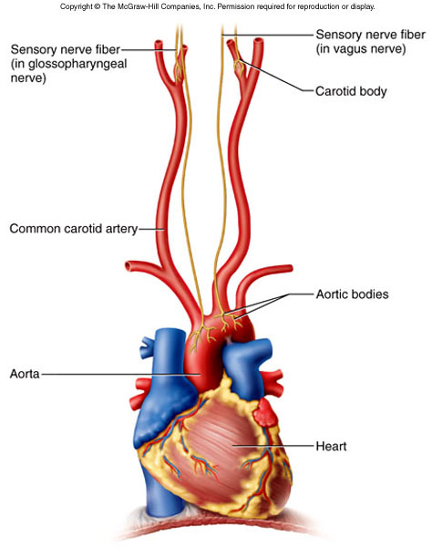
Peripheral Chemoreceptor Paths

Slide 42
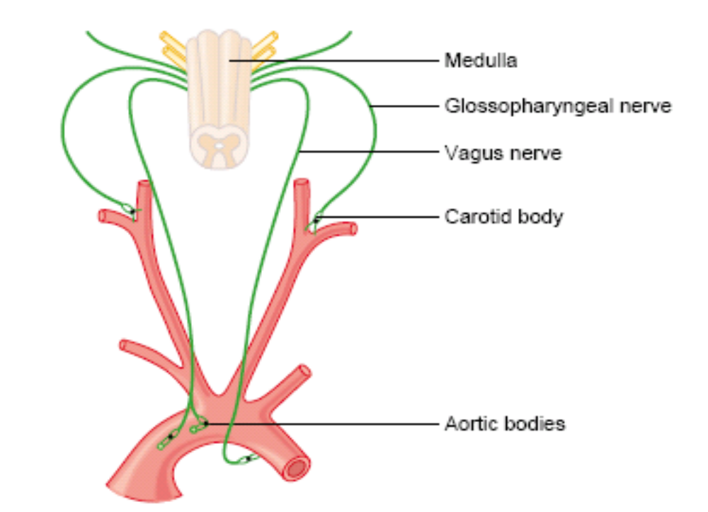
Chemoreceptors of respiration

Slide 43

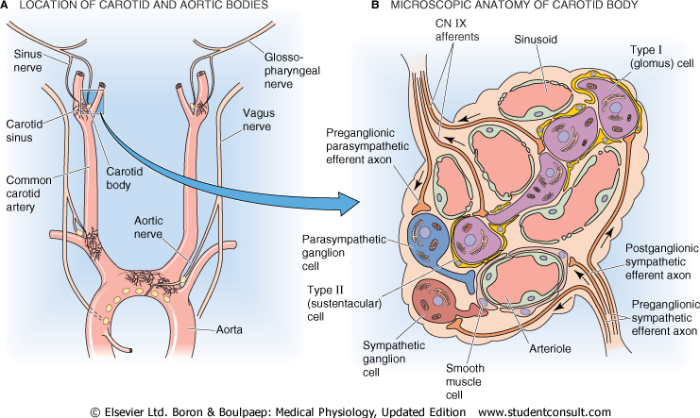

Slide 44
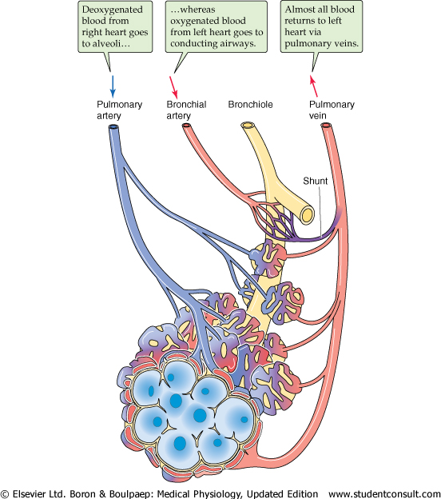

Slide 45
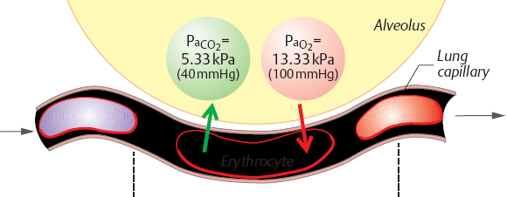
Alveolar gas exchange

Slide 46
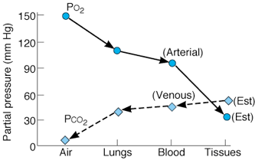
Summary of PO2 and PCO2 values
  both O2 and CO2 diffuse "downhill" process

Slide 47
Fate of oxygen in respiratory system
Mechanism by which atmospheric oxygen is provided to the tissue has three main components:
  Trap of O2
  Transport of O2
  Transfer of O2

Slide 48
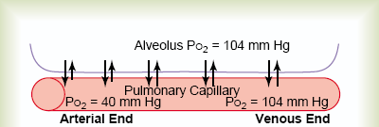
Trap and Transfer of oxygen

Slide 49
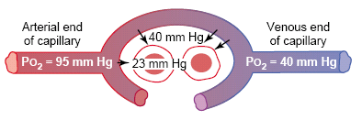
Transfer of oxygen

Slide 50
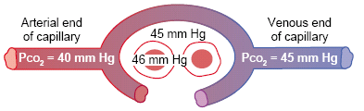
Transfer of CO2

Slide 51
Blood transports CO2 from the tissue cells to the lungs in three forms
  1. Dissolved in plasma (7–10%).
  2. Chemically bound to hemoglobin (just over 20%). In this form, CO2 is carried in the RBCs as carbaminohemoglobin
  3. As bicarbonate ion in plasma (about 70%).

Slide 52
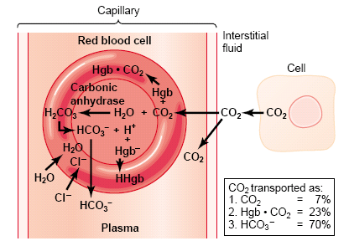
Transport of CO2

Slide 53
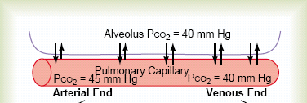
Expulsion of carbon dioxide

Slide 54
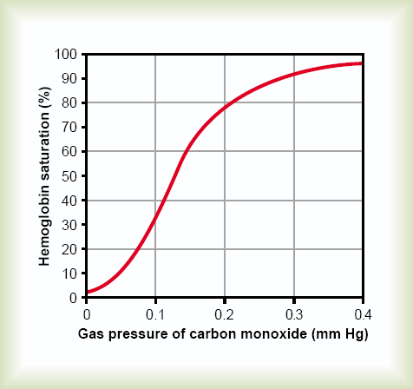
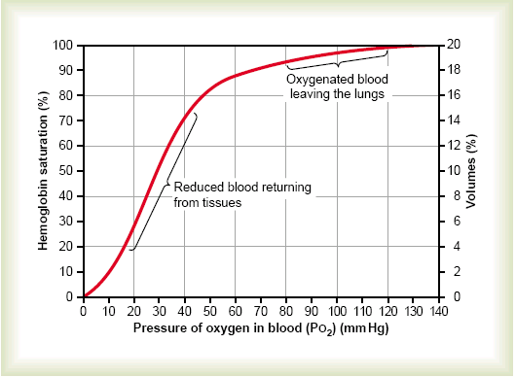
CO poisoning

Slide 55
Hypoxia
  hypoxic hypoxia - usually due to inadequate pulmonary gas exchange
    high altitudes, drowning, aspiration, respiratory arrest, degenerative lung diseases
  stagnant hypoxia - inadequate circulation,
  anemic hypoxia – anemia, CO poisoning
  histotoxic hypoxia - metabolic poison (cyanide), diphteria
Signs: cyanosis - blueness of skin
Primary effect: tissue necrosis, organs with high metabolic demands affected first,

Slide 56
Cyanosis
5 g. deoxygenated Hb per 100 ml of blood.
Central cyanosis: hypoxic hypoxia
Peripheral cyanosis :stasis of blood in tissue capillaries
Cyanosis in different hypoxia:
1.hypoxic 2.anaemic 3.stagnant 4. histotoxic
yes no yes no

Slide 57
Dyspnoea:
if the % BR falls below 60%.
Causes: due to
-altered discharge from airway receptors, lung receptors or respiratory muscle proprioceptors.
-left ventricular failure, the lungs are congested.
-bilateral paralysis of the diaphragm.
(orthopnea)

Slide 58
Respiratory failure
Hypoxia: cyanosis, tachicardia and mental confusion
Hypercapnia: headache, slurred speech and flapping tremors.
Asphyxia: hypoxia with hypercapnia.

Slide 59
Effects of Hydrogen Ions
pH of CSF (most powerful respiratory stimulus)
Respiratory acidosis (pH < 7.35) caused by failure of pulmonary ventilation
  hypercapnia: PCO₂ > 43 mmHg
Respiratory alkalosis (pH > 7.45)
  hypocapnia: PCO₂ < 37 mmHg
pH imbalances can be because of metabolic causes
  uncontrolled diabetes mellitus
    (deep rapid breathing)

Slide 60
Chronic Obstructive Pulmonary Disease
Asthma
  allergen triggers histamine release
  intense bronchoconstriction (blocks air flow)
Other COPD’s usually associated with smoking
  chronic bronchitis
  emphysema

Slide 61
Chronic Obstructive Pulmonary Disease
Chronic bronchitis
  cilia immobilized and ↓ in number
  goblet cells enlarge and produce excess mucus
  sputum formed (mucus and cellular debris)
    ideal growth media for bacteria
  leads to chronic infection and bronchial inflammation

Slide 62
Chronic Obstructive Pulmonary Disease
Emphysema
  alveolar walls break down
    much less respiratory membrane for gas exchange
      healthy lungs are like a sponge; in emphysema, lungs are more like a rigid balloon
  lungs fibrotic and less elastic
  air passages collapse
    obstruct outflow of air
    air trapped in lungs

Slide 63
Effects of COPD
↓ pulmonary compliance and vital capacity
Hypoxemia, hypercapnia, respiratory acidosis
  hypoxemia stimulates erythropoietin release and leads to polycythemia
cor pulmonale
  hypertrophy and potential failure of right heart due to obstruction of pulmonary circulation

